Slide 1
CHAPTER 9
Chemical Equilibrium
Rates of Reaction
Collision Theory
Equilibrium
Notes:
1

Slide 2
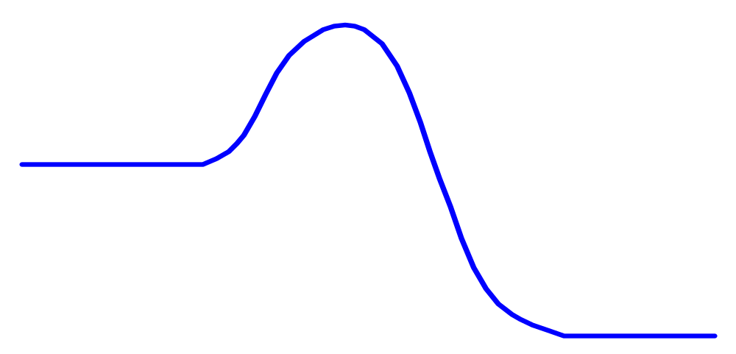
Reaction Rates
2H_{2(g)} + O_{2(g)} → 2H₂O + Energy
H_{2(g)} + O_{2(g)} may stay together for lifetime without reacting to form water.
Very stable
product
(ΔH < 0)
−ΔH
Energy
Rxn Progress
Just because something has the potential to react
doesn’t mean it will do so immediately.

Slide 3
Chemical kinetics
The study of reaction rates (speed)
Enthalpy Only tell us if a reaction will & occur but not how long it will Entropy take.
Kinetics Measures the time required for a reaction to occur.
Notes:
17

Slide 4
Chemical kinetics
Kinetics of a chemical reaction can tell us -
  how long it will take for a reaction to reach completion.
  how chemicals react to form products (mechanism).
  effects of catalysts and enzymes.
  how to control a reaction.
Notes:
18

Slide 5
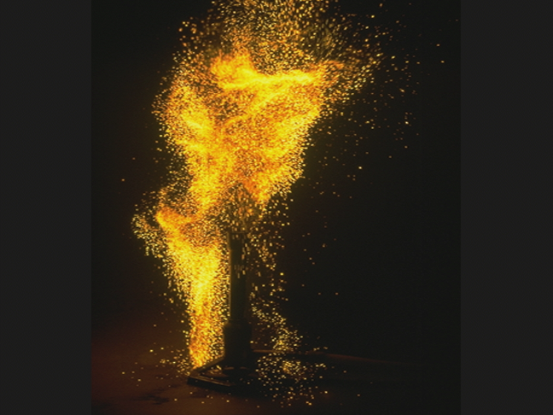
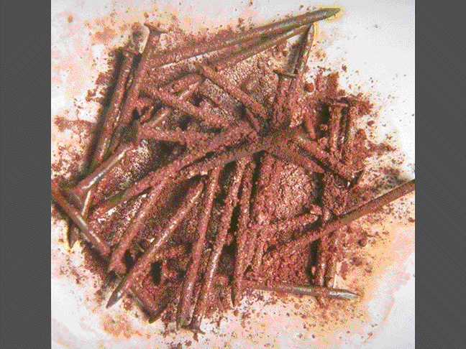

Reaction Rates
Speed at which reactant is used up.
Speed at which product forms.
Fast:
Oxidation: Paper burning
Slow:
Oxidation: Nails rusting
Paper turning yellow

Slide 6
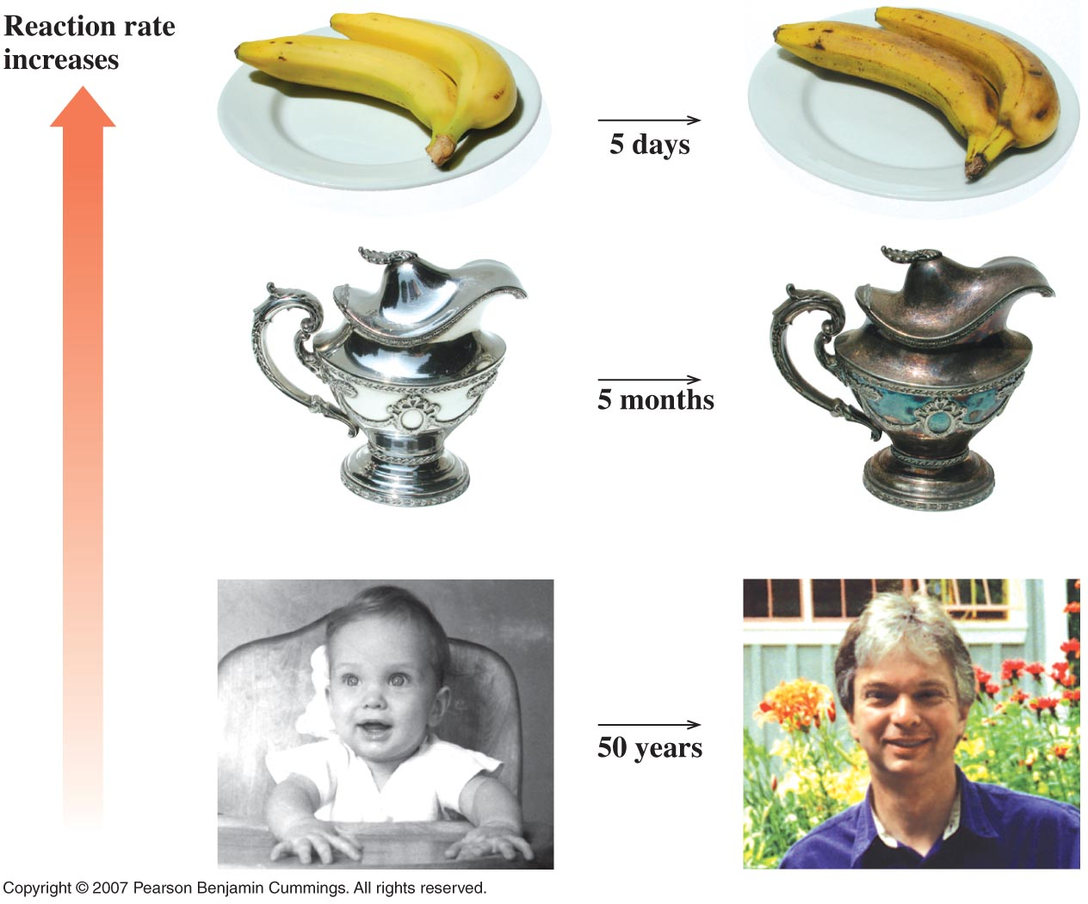
Figure 9.1
Reaction Rates
Fast:
Slow:
Slower:

Slide 7

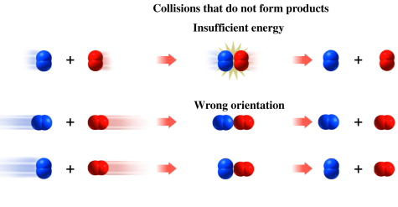
Effective collisions
A reaction won’t happen if:
Insufficient energy to break bonds.
N₂ O₂
N₂ O₂
Molecules are not aligned correctly.
Notes:
19

Slide 8
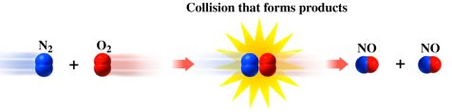
Collision Theory
For reactants to make products:
  1. Molecules must collide
    (solvents really help)
2. They have to be aligned correctly.
3. They have to have enough E.
(Parked cars don’t collide)
Notes:
19

Slide 9
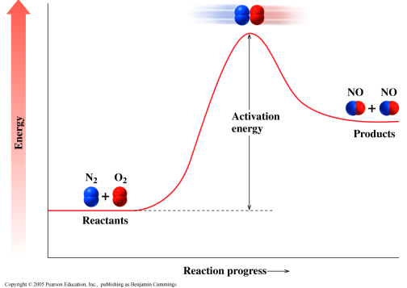
Activation Energy
The activation energy E_{act}
Is the minimum energy needed for a reaction to take place upon proper collision of reactants.

Slide 10
Energy diagrams
A temporary
state where
bonds are
reforming.
Show the ΔE during
a reaction.
Activated
Complex
Activation energy E_{act}
Energy
−ΔH

Slide 11
Factors Influencing Rxn Rates
Reaction rates can be affected by :
  Reactant structure(polar vs. nonpolar)
    state of reactants (gas vs liq.)
    Sub division, sugar cube
  Concentration of reactants
        (medications)
  Temperature
        (hypothermia & metabolism)
  Catalyst (H₂O₂ & blood)
  Pressure (increases reaction rate)
Notes:
25

Slide 12
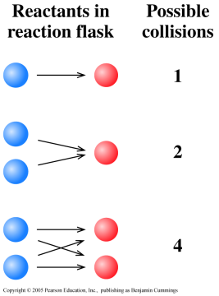
Reaction Rates
Concentration :
More Reactants:
More cars → More collisions
If
Increase reactant concentration
then
Increase # of collisions
so
Increase reaction rate.

Slide 13
Reaction Rates
Sub division
2. More Reactants:
More surface area → More collisions
8 blocks:
34 surfaces
8 blocks:
24 surfaces
Notes:
19

Slide 14

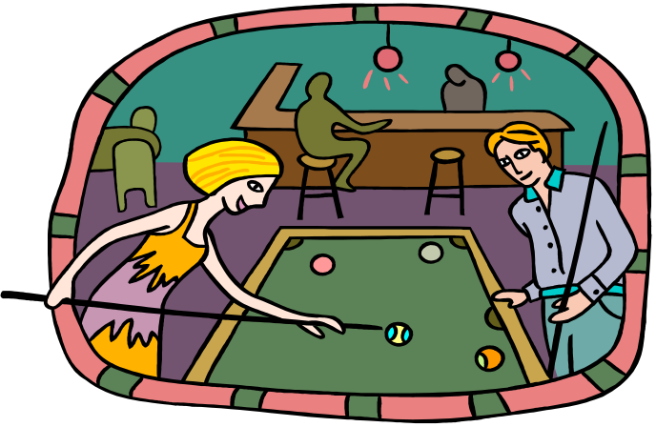
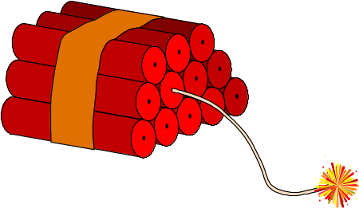
Reaction Rates
Temperature:
3.Higher Temperature:
Faster cars → More collisions
More Energy → More collisions
Reacting molecules move faster,
providing colliding molecules w/ E_{act}.
Notes:
19

Slide 15
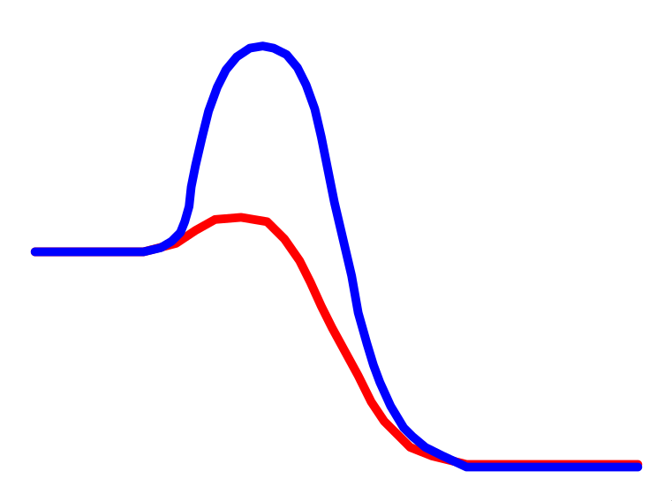
Reaction Rates
Catalyst:
4. Adding a Catalyst:
Lower E_{act} → More collisions
Uncatalysed reaction

Slide 16
Reaction Rates
Catalyst:
4. Adding a Catalyst:
Lower E_{act} → More collisions
Uncatalysed reaction
Catalysed reaction
Lower activation energy
Alters reaction mechanism but not products
Is not used up during the reaction.

Slide 17
Reaction Rates
Catalyst:
4. Adding a Catalyst:
Lower E_{act} → More collisions
Uncatalysed reaction
Catalysed reaction
Lower activation energy
Enzymes are biological catalysts.

Slide 18
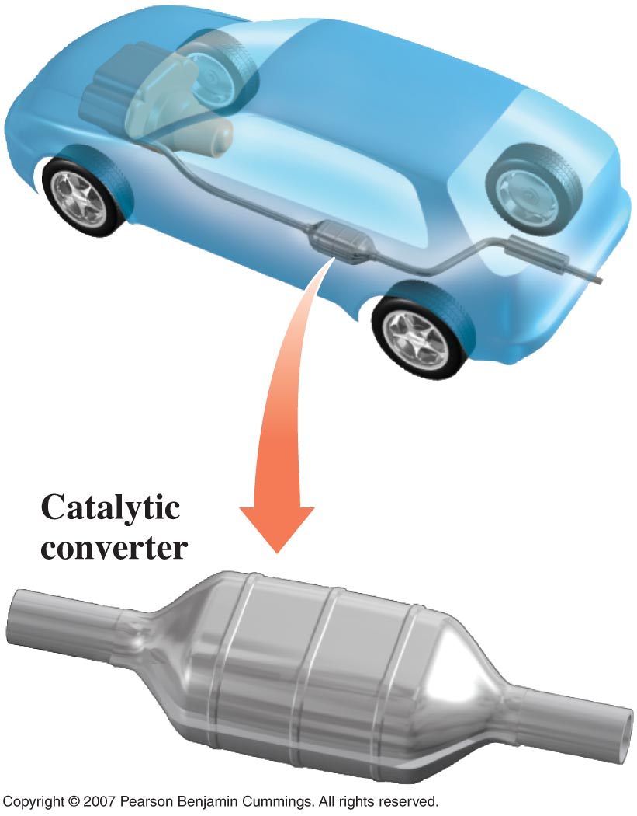
Catalytic Converter

Slide 19
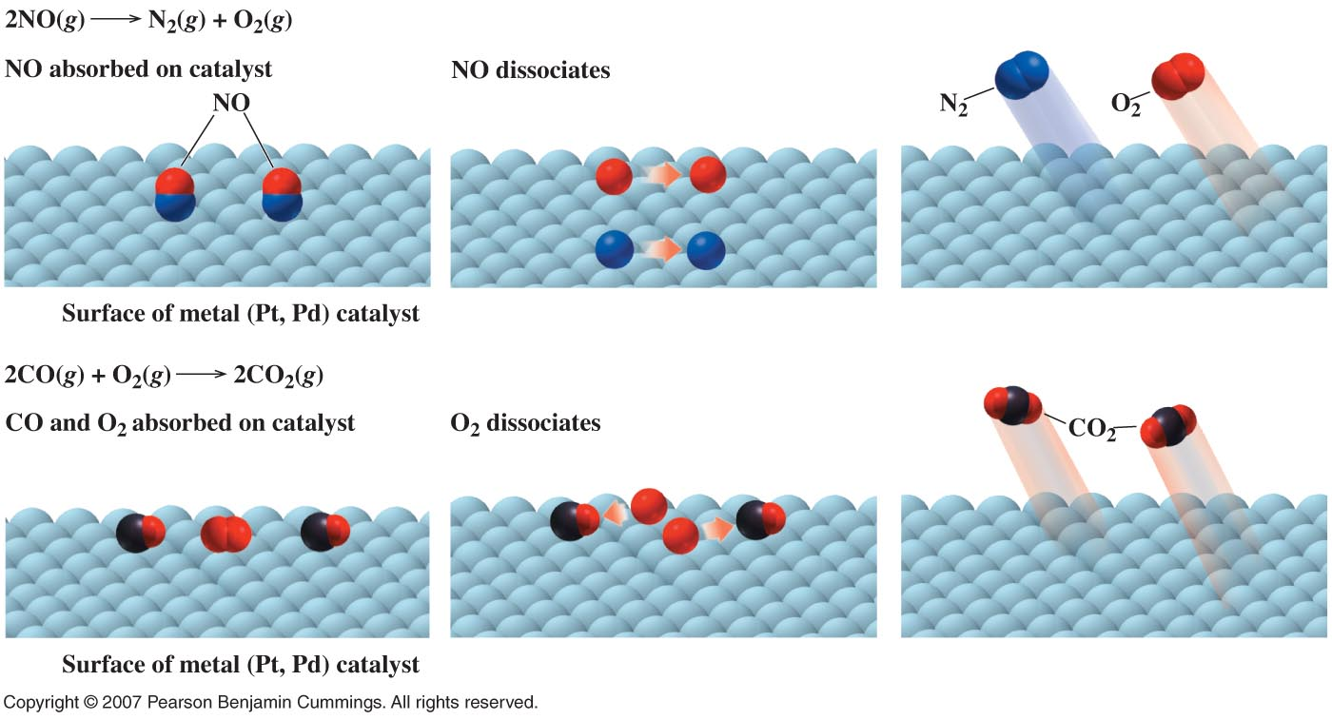
Catalytic Converter

Slide 20
Reaction Rates
Pressure:
5. In gases, greater conc
Gas Laws
As the volume halves the pressure doubles, they are inversely proportional. Boyles Law.
So as the pressure doubles the concentration effectively doubles.
PV=nRT

Slide 21
Learning Check
State the effect of each on the rate of reaction as
(I) increases, (D) decreases, or (N) no change.
A. Increasing the temperature.
B. Removing some of the reactants.
C. Adding a catalyst.
D. Placing the reaction flask in ice.
E. Increasing the concentration of a reactant.

Slide 22
Solution
State the effect of each on the rate of reaction as
(I) increases, (D) decreases, or (N) no change.
A. Increasing the temperature. (I)
B. Removing some of the reactants. (D)
C. Adding a catalyst. (I)
D. Placing the reaction flask in ice. (D)
E. Increasing the concentration of a reactant. (I)

Slide 23
Learning Check
Indicate the effect of each factor listed on the rate of the following reaction as
  (I) increases, (D) decreases, or (N) none:
2CO(g) + O₂(g) → 2CO₂ (g)
A. Raising the temperature
B. Removing O₂
C. Adding a catalyst
D. Lowering the temperature

Slide 24
Solution
Indicate the effect of each factor listed on the rate of the following reaction as
  (I) increases, (D) decreases, or (N) none:
2CO(g) + O₂(g) → 2CO₂ (g)
A. Raising the temperature (I)
B. Adding O₂ (D)
C. Adding a catalyst (I)
D. Lowering the temperature (D)

Slide 25
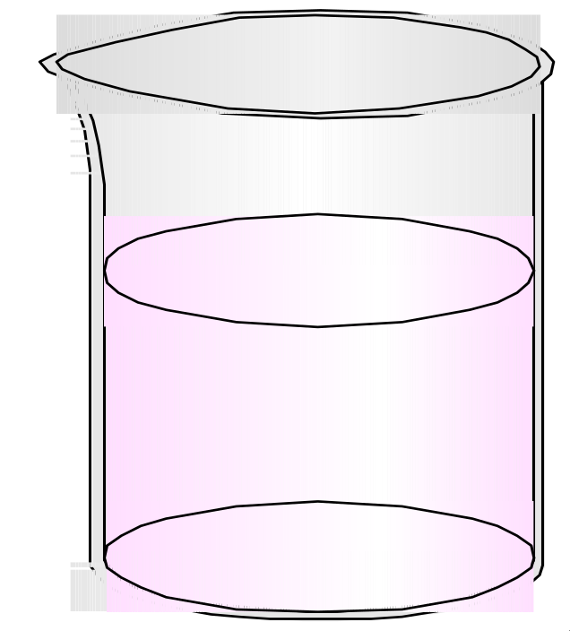
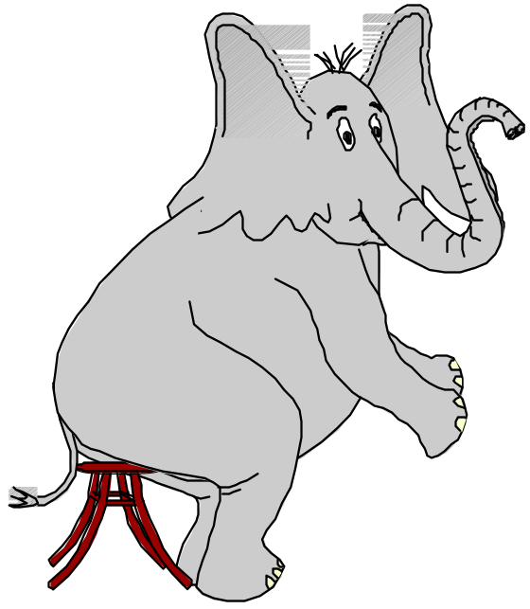
Dynamic Equilibrium
A state where the forward and reverse conditions occur at the same rate and concentration of products and reactants remains constant .
I’m in static
equilibrium.
Dynamic
Equilibrium
Notes:
30

Slide 26
Physical equilibrium
Dynamic process
Rate of forward Rxn = Rate of reverse Rxn
H₂O_{(l)} H₂O_{(g)}
(reactant) (product)
Dynamic
Equilibrium
Concentration of reactants and products remain constant over time.
Notes:
32

Slide 27
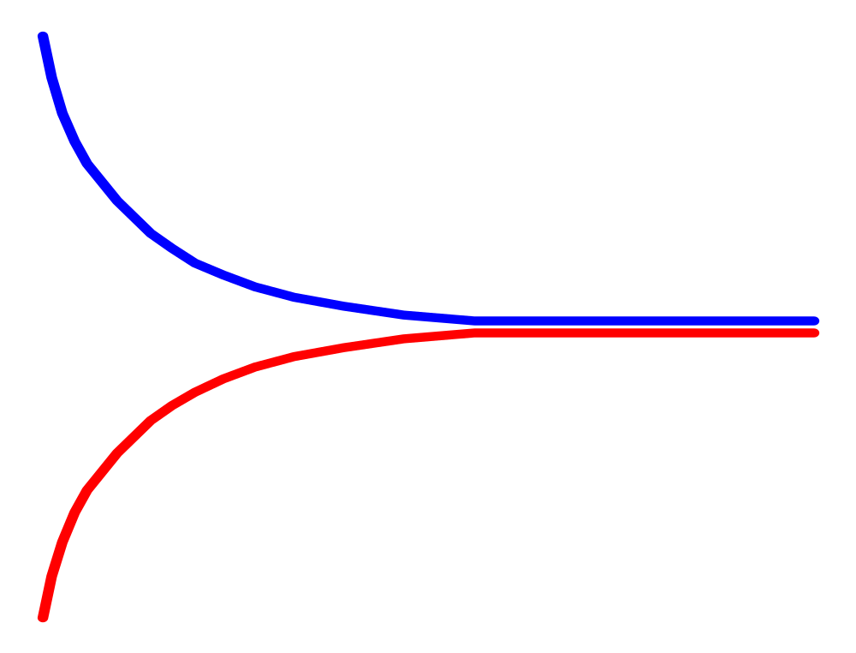
Equilibrium and reaction rates
H₂O_{(l)} H₂O_{(g)}
(reactant) (product)
A point is ultimately
reached where the
rates of the forward
and reverse reactions
are the same.
At this point,
equilibrium
is achieved.
Reaction rate
Time
Notes:
31

Slide 28
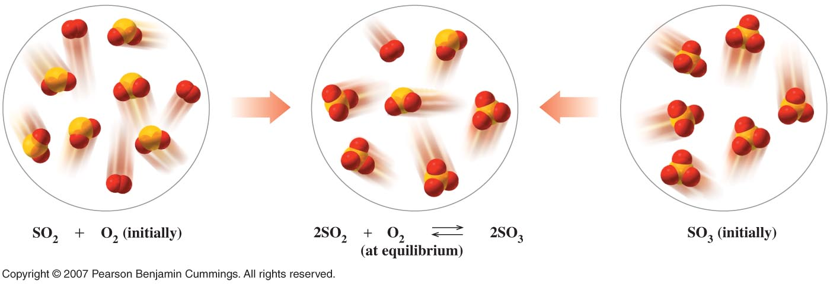
Figure 9.8
2SO_{2(g)} + O_{2(g)} 2SO_{3(g)}
At Equilibium
SO_{2(g)}+O_{2(g)}
Initially
SO_{3(g)}
Initially

Slide 29
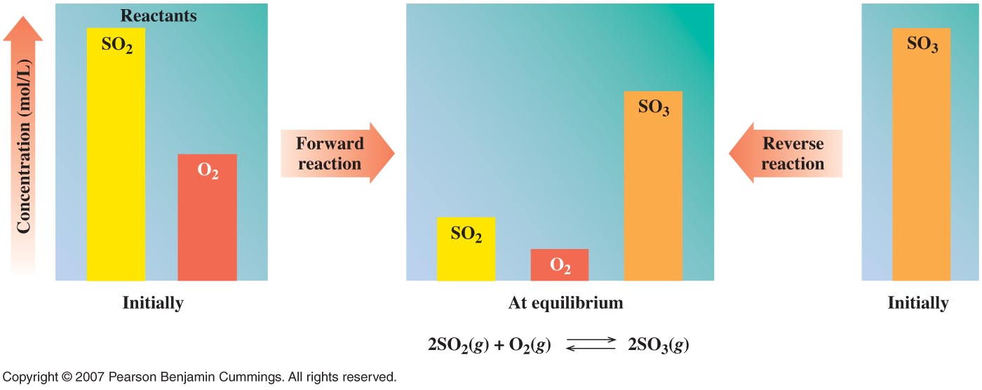
Figure 9.9
2SO_{2(g)} + O_{2(g)} 2SO_{3(g)}
At Equilibium
SO_{2(g)}+O_{2(g)}
Initially
SO_{3(g)}
Initially

Slide 30
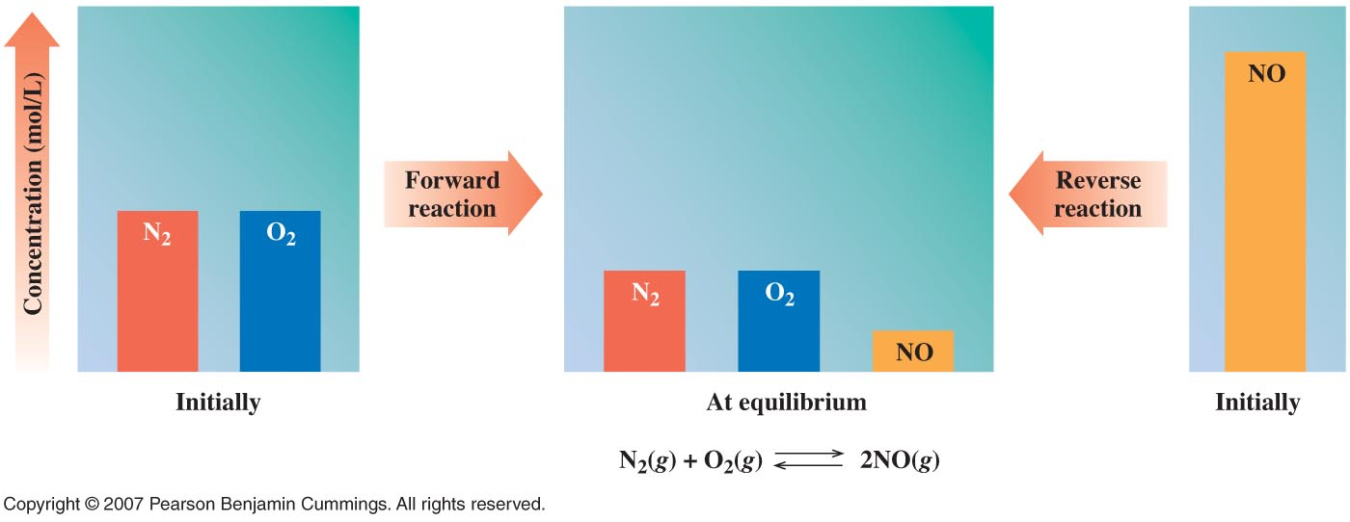
Figure 9.10
N_{2(g)} + O_{2(g)} 2NO_{(g)}
At Equilibium
N_{2(g)}+O_{2(g)}
Initially
NO_{(g)}
Initially

Slide 31
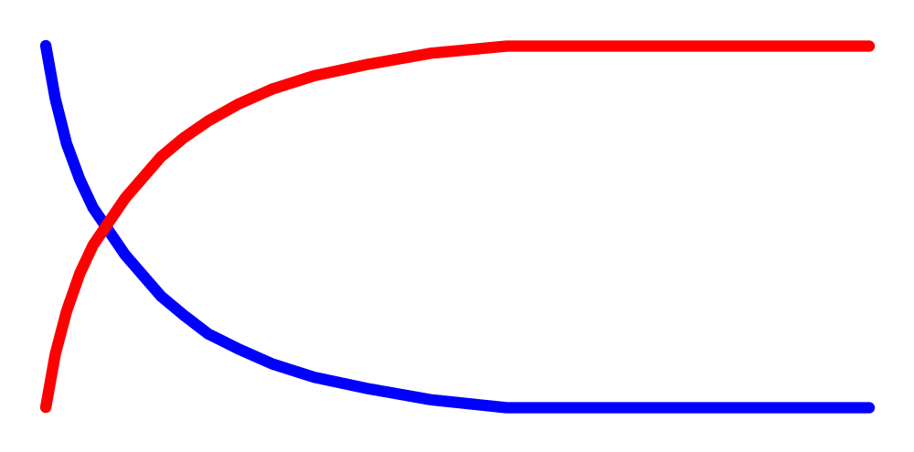
Equilibrium
Kinetic Equilibrium
Region Region
Concentration of
reactants and products
remain constant over time.
Concentration
Time
Notes:
33

Slide 32
Equilibrium constant (K)
_{Equilibrium expression}
(for any reaction at constant temperature)
aA + bB cC + dD
reactants
products
[C]^{c} [D]^{d}
[A]ª [B]^{b}
coefficients
K_{eq} =
moles per litre
Notes:
34

Slide 33
Equilibrium constant K
Note gases and aqueous species to be used in K expression, solids and liquids have a fixed concentration and so not in K calc.
K has a constant value if concentration and pressure the same but varies with temperature. Eg H₂O ↔ H⁺ + OH⁻
At 25°C for water is 1x10⁻¹⁴, whereas water at
0°C is 0.14x10⁻¹⁴ so favours reverse reaction
100°C is 55x10⁻¹⁴ so favours forward reaction

Slide 34
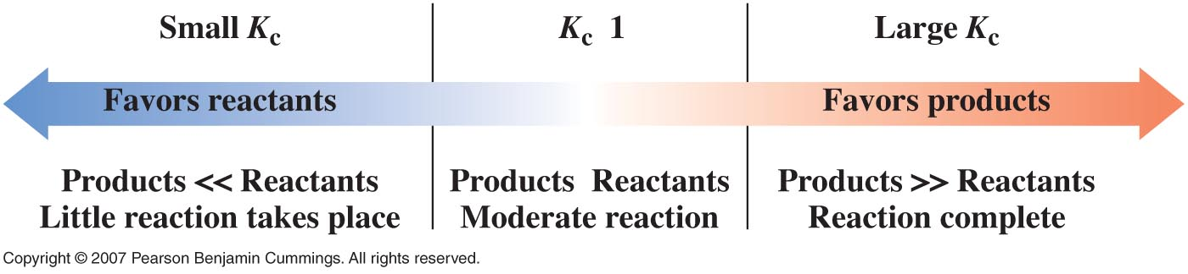
Figure 9.11
Equilibrium constant (K)
aA + bB cC + dD
reactants
products
[C]^{c} [D]^{d}
[A]ª [B]^{b}
K_{eq} =

Slide 35
Equilibrium constant (K)
  N_{2(g)} + 3 H_{2(g)} 2 NH_{3(g)}
[ NH₃ ] ²
K_{eq} =
[ N₂ ] [ H₂ ] ³
Notes:
36

Slide 36
Le Chatelier’s principle
“If a system is at equilibrium and a change in conditions is imposed on the system, then the system will re-establish a new equilibrium in such a way as to partially counteract the imposed change.”

Slide 37
Le Chatelier’s principle
Stress causes shift in equilibrium
Adding or removing reagent
  N_{2(g)} + 3 H_{2(g)} 2 NH_{3(g)}
N₂
Add more
N₂?
Reaction shifts to the right
[NH₃] inc, [H₂] dec
Notes:
35

Slide 38
Le Chatelier’s principle
Adding or removing reagent
  N_{2(g)} + 3 H_{2(g)} 2 NH_{3(g)}
NH₃
Add more
NH₃?
Reaction shifts to the left
[N₂] and [H₂] inc

Slide 39
Le Chatelier’s principle
Adding Pressure
affects an equilibrium with gases
N_{2(g)} + 3 H_{2(g)} 2 NH_{3(g)}
4 mol
of reactants
Add P?
2 mol
of products
Increasing pressure causes the equilibrium to shift
to the side with the least moles of gas.

Slide 40
Le Chatelier’s principle
Temperature can also have an effect.
For exothermic reactions
reactants products + heat
Raising the temperature shifts it to the left.
For endothermic reactions
    heat + reactants products
Raising the temperature shifts it to the right.
Notes:
41

Slide 41
Fe ³⁺ + SCN⁻ FeSCN ²⁺
Iron and thiocyanide are in equilibrium with the ferrocyanide ion.
1. What happens when Fe ³⁺ is added ?
2. What happens when SCN ⁻ is added ?
3. What happens when Fe ³⁺ is removed ?

Slide 42
Le Chatelier’s principle
FeCl₃ + 3NH₄CNS Fe(CNS)₃ + 3NH₄Cl
Yellow Red
1. What happens when FeCl₃ is added ?
2. What happens when NH₄CNS is added ?
3. What happens when Fe(CNS)₃ is removed ?

Slide 43
Ocean Acidification
https://www.youtube.com/watch?v=gHdTso94Xt4
https://www.youtube.com/watch?v=zyn9vL4EIvY
https://www.youtube.com/watch?v=wNbZHI-W_JM
https://www.youtube.com/watch?v=5cqCvcX7buo

Slide 44
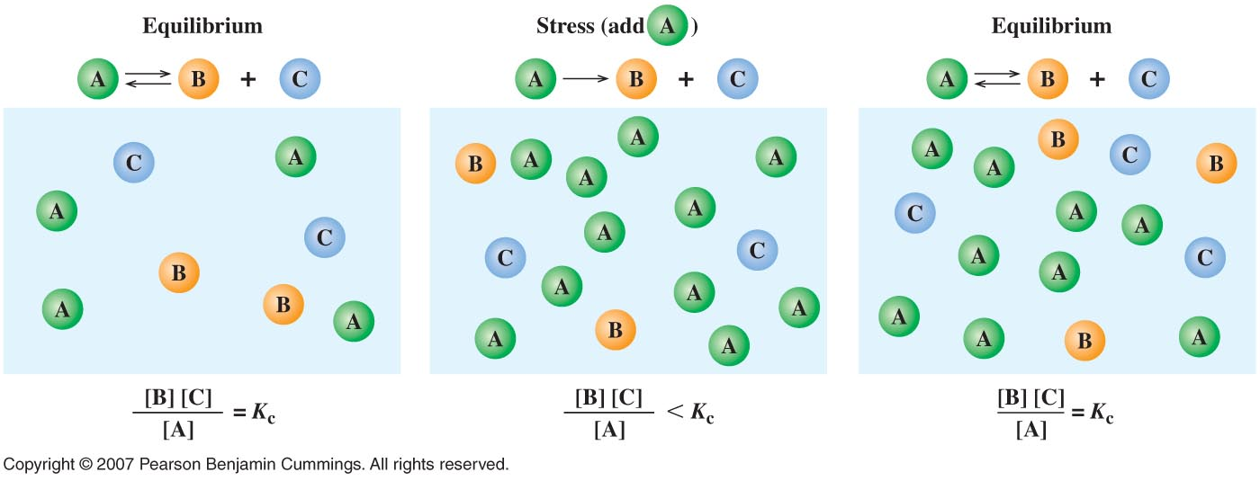
Figure 9.12

Slide 45
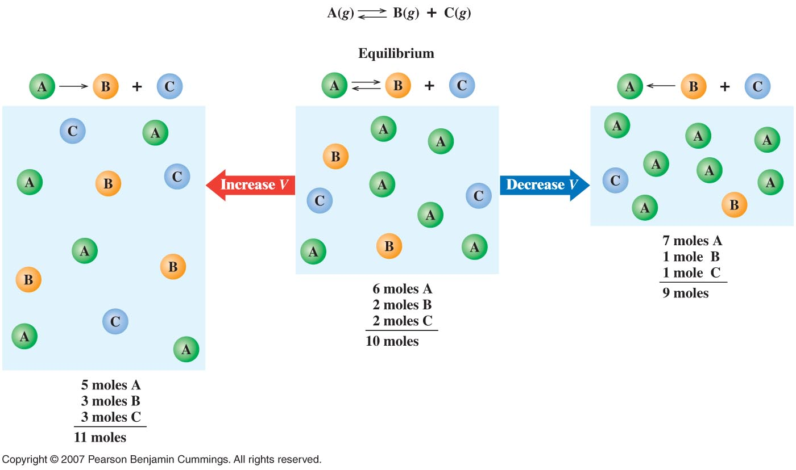
Figure 9.13

Slide 46
Example
O₂ transport in blood
Equilibrium equation
Hb + 4 O₂ Hb(O₂)₄
lungs = abundance of O₂ :
Inc
Cells = lack of O₂ :
Dec

Slide 47
Example
O₂ transport in blood
Equilibrium equation
Hb + 4 O₂ Hb(O₂)₄
Equilibrium expression
[Hb(O₂)₄]
K_{Hb} =
[Hb] [O₂]⁴
Notes:
37

Slide 48
Example
O₂ transport in blood
lungs = abundance of O₂ :
Hb + 4 O₂ Hb(O₂)₄
Oxygen is picked up by the hemoglobin.
Cells = lack of O₂ :
(Hypoxia) :
Hb + 4 O₂ Hb(O₂)₄
Oxygen is given up by the hemoglobin.
50% more red blood cells in persons
living at high altidudes.
Notes:
38

Slide 49
O₂ transport
Lets say that
[Hb(O₂)₄]
K_{Hb} =
= 5.0 x10⁵
[Hb] [O₂]⁴
The ratio of oxygenated
to unoxygenated
hemoglobin is:
[Hb(O₂)₄]
K_{Hb}
x [O₂]⁴
=
[Hb]
Notes:
39

Slide 50
O₂ transport
If the solubility of O₂ in blood at 37ºC = 0.1M.
(in the lungs)
[Hb(O₂)₄]
K_{Hb}
x [O₂]⁴
=
= 5.0x10⁵ x 0.1⁴
[Hb]
= 50
In the capillaries, the O₂ level is about 0.001M
so -
[Hb(O₂)₄]
K_{Hb}
x [O₂]⁴
=
= 5.0x10⁵ x 0.001⁴
[Hb]
= 5.0 x 10⁻⁷
Notes:
40

